Slide 1
Online security awareness
For the common (wo)Man

Slide 2
Table of COntents
Course Objectives…………………………………………... 3
Authors……………………………………………………… 4
Passwords…………………………………………………… 6
Emails……………………………………………………… 12
Scams and ID Theft………………………………………… 19
Social Engineering………………………………………....... 24
Securing Your Online Presence…………………………...... 28
Defensive Tools…………………………………………….. 33
What To After Becoming A Victim………………………….. 37
Beyond This Course……………………………………….. 44
Off The Rails Cyber Security Podcast……………………... 47

Slide 3
Course objectives
This course is designed to be free and taught by anyone to any group.
Develop a basic understanding of security measures needed for the modern era of technology.
How to detect, avoid, and navigate through potentially bad emails.
How to avoid becoming a victim of identity theft.
Develop an understanding on common social engineering scams.
How to secure your online presence.
What to do if you become a victim of identity theft.
How to get tools to help defend yourself before or after becoming a victim of thieves.

Slide 4
Authors
This course was developed and sponsored by Off The Rails: Cyber Security Podcast hosts:
Brandon Rickman
Matthew Weidner
Liam Seeley
Gina Cramer

Slide 5

How to access this Course for later
Download at https://github.com/offtherailspod/offtherailspod.github.io/tree/master/blog/sec-aware/

Slide 6
Part i: Passwords
Keys to the computer world

Slide 7
Strength in numbers
The have’s
The have not’s
Passwords get their strength in three main areas:
Length – a general rule of thumb is 8 to 10 characters.
Upper and lower case combined
Special characters - !@#$%^&*(){}][;”
Random characters are your friends.
Use ANY word in any dictionary
Use personal sequence of numbers
Changing letters for symbols i.e.:
Pa$Sw0rD1 for password1
Use the same password on different accounts.
Change ending/beginning numbers when required to update password.
Password12 → Password13

Slide 8
Password Managers & Generators
A simple way to ensure passwords are kept safe and easy for you to retrieve, is to use Password Managers, aka key lockers.
There are several ones out there, some paid, some free.
https://1password.com (paid) $2.99/month billed annually, across all devices.
https://keepass.info/ (free) held locally on pc and connects across accounts.
Use password generators to generate random 10 to 16 character passwords. (Longer is better)
Most password managers will have a generator included. (Keepass does)
https://my.norton.com/extspa/idsafe?path=pwd-gen is an online password generator.

Slide 9
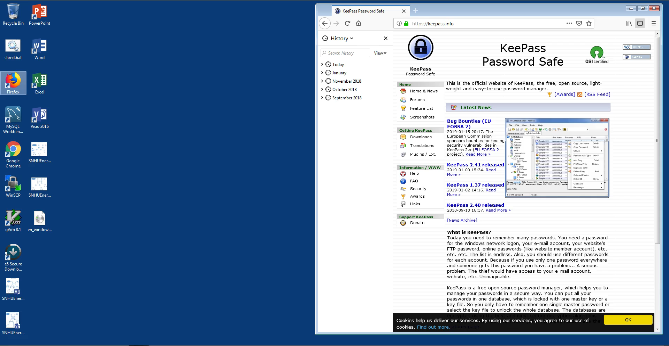
Using keepass (6:04 min) by matt weidner
Download and install Keepass
Create New database
Saved to the Desktop
Add new entry
Generate new password
Store a copy of database on USB drive and lock USB drive in safe or lock box
Open database and password for before logging into the website you are using
**NOTE**
Keepass is encrypted at rest, meaning that it would have to be decrypted to gain access to your passwords.

Slide 10
MFA, biometrics, and yubikey
MFA (Multi-Factor authentication
Biometrics and Yubikey
Defined as: combines two or more independent credentials:
User password
Security token (yubikey)
User biometrics
The goal being to layer the defense with several ways to ensure the right person is using the computer/website, as necessary.
https://www.yubico.com/ - is the makers of Yubikey
Biometrics (fingerprint, facial recognition, and iris scanning) are additional forms of authentication

Slide 11
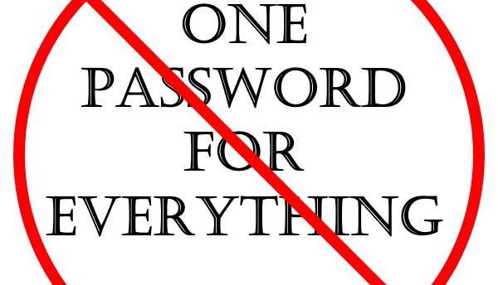
All for one and one for all passwords

Slide 12
Part ii: Emails
The internet’s quick connection to sharing information

Slide 13
Phishing emails
Defined as: fraudulent attempt to obtain sensitive information such as usernames, passwords and credit card details by disguising as a trustworthy entity in an electronic communication. Wikipedia
These types of emails attempt to gather information about you.
They can be faked with what seems like legitimate company information. (No company IT Department should ask for your login information or personal identifying information, PPI, through email).
If you did not request the email related to sensitive information, contact the company that is represented in the email. DO NOT USE THE NUMBER PROVIDED IN THE EMAIL

Slide 14
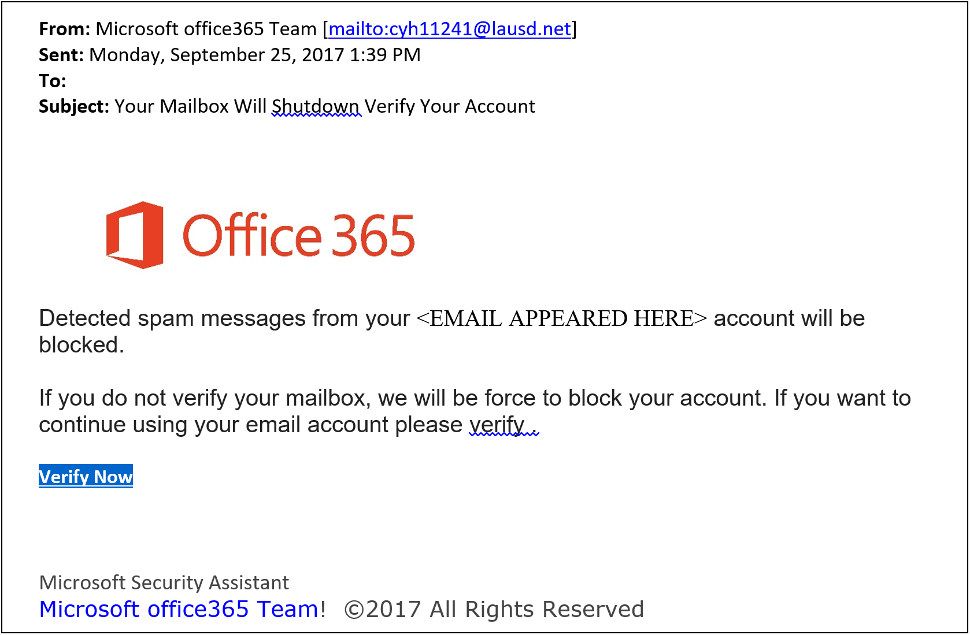
Fake email #1
Header: “o” in office isn’t capitalized. This is their logo and brand name, they aren’t going to mess that up. Sender email does not have a domain [area after @ symbol] that comes back to a Microsoft domain.
Body: Outlook already blocks Spam emails, go look at the folder in your email labeled SPAM.
“verify .” All though this is small, it is a tell-tell sign that a human wrote this verses a computer auto-generated email, which this would be from Microsoft.

Slide 15
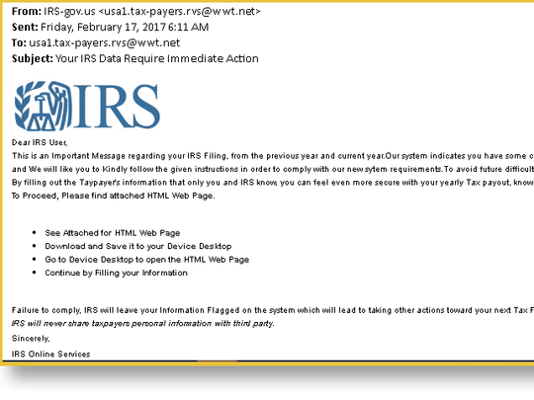
Fake email #2
Header: email does not come back to irs.gov after the @ in the from tag.
If you are not expecting an attachment DO NOT touch it or even click on it. Some malware is set to install upon download.
The email states you must see an attached HTML page, why wasn’t it just linked in the email?
Last, “continue filing out your information”. This is the IRS, they have your information.

Slide 16
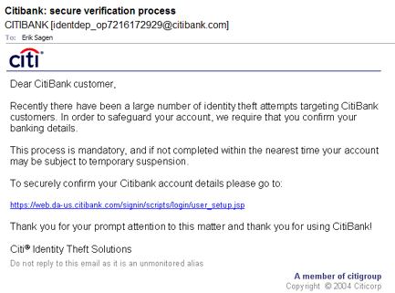
Fake email #3
This email is a good one. The email from CitiBank appears to be legitimate. The website appears to be a possible domain from CititBank.
The major problem is that CitiBank SHOULD not and more than likely WILL not be sending an email asking you to verify your account.
If you want to check if CitiBank needs you to update your information, utilize the message feature in your secure online banking platform. They will send something there.

Slide 17
Deceptive links
Check the return email address: does the Domain (area after the @ symbol) match the company sending the email; Most companies will have their own domain from email and websites that are name after their business. Try it! Go to a known website that you trust and then also look at any emails from that company. Do they match?
Unexpected files in email, even if someone you know but still weren't expecting a file, is a no go until verified by the sender.
Hovering over links to see real target: move your mouse over top of the link; DO NOT click it; after a few seconds the URL (web address) will show up on a pop up next to your mouse pointer.
Do not to trust bit.ly links: these are used legitimately sometimes to shorten long URLs, but are great ways to hide where the actual link sends you.

Slide 18
Online banking
Use the new password standards we learned about in Part I of this presentation to have a stronger password. Maybe even use your new Password Manager?
Login using your username and password.
Find your message center: this is going to be where all important and sometimes not so important contact between you and your bank will take place. All banks have this feature.
When you are done with your business on the website, be sure to LOG OUT. Some banks and other website will automatically log you out after an inactivity period, but make it a habit to log out.

Slide 19
Part iii: scams and Identity theft
The way the new bad guys are trying to steal your money

Slide 20
What is an online scam?
Online Scam is defined as: is a term used to describe any fraudulent business or scheme that takes money or other goods from an unsuspecting person. With the world becoming more connected thanks to the Internet, online scams have increased, and it's often up to you to help stay cautious with people on the Internet.
Types of Online Scams: Phising, Auction Frauds, Catfish, Donation Scam, Cold Call Scam, 419 aka “Long lost African relative scam”, Online Survey Scam, Chain Mail
(https://www.computerhope.com/jargon/s/scam.htm)

Slide 21
Other types of scams
Scams can come from phone calls, emails, and even websites or google searches.
Google searches: ensure you are not clicking an add link; they are using the first few returns on a search; they can be fraudulent; notify google.com if you find one (Google does not have a phone number customer support, its all online and thru email).
IRS scams are common: most of the time they will call and say you have a warrant for your arrest. This is false. If the IRS wants to arrest you they will just show up at your house or work. The IRS will always try and call or email when there is a problem. The IRS has your information and if they want your money they will just take it from your paycheck through your employer.
Dating scams: Military or Catfishing, dating scams are meant to mainly hurt the other person by getting you excited about the person you are meeting and its not who you though it was. There have been times where people were extoreted online because they sent inappropriate pictures and the receiver (scammer) states they will expose the sender unless they pay. This IS illegal, gather as much information about the other person as you can.
Utility company scams: They need to install a new electric meter or work on the cable or satellite system update, but you need to pay a deposit before they can start. Sometimes the company isn’t even service the area where you live.

Slide 22
Update security breaches
Have you received an email that your information was part of a security breach?
That you need to get credit monitoring?
Everyday, it seems there is a new major security breach at companies that we entrust with our information.
When you see these in the news head over to Troy Hunt’s website www.haveibeenpwned.com
Here you will find out if your email is part of any data breaches dating back.
Major Data Breaches: OPM (Federal Government HR), Experian, Medicaid, Yahoo, and many more.

Slide 23
What if I’m Being Scammed Right now
Have you given them access to your computer or bank account?
Are you on the phone with them or are they expecting a return call?
If you have not given them access to your computer (sometimes even if you have given remote access) unplug the computer from the power. This will stop their ability to continue accessing your info. Also go unplug the internet router. This stops all outside access.
If you are on the phone with them or they tell you they want you to go do “something” call the local police and have an officer come out. You can alternatively go to you police department’s lobby and request to speak with an officer. They are open 24/7 so don’t wait, make a report. Even if there hasn’t been a offense yet.
Contact your bank and credit card companies to alert them of the fraud (only if you have given them this info).
NEVER get gift cards for payment or send money via Moneygram/Western Union unless you know personally know who and where you are sending the money. Both of these companies clearly spell this out in the fine print.

Slide 24
Part iV: Social Engineering
Gathering intel about you to take your money and your identity

Slide 25
Social engineering defined
the art of manipulating people so they give up confidential information. The types of information these criminals are seeking can vary, but when individuals are targeted the criminals are usually trying to trick you into giving them your passwords or bank information, or access your computer to secretly install malicious software–that will give them access to your passwords and bank information as well as giving them control over your computer.
https://www.webroot.com/us/en/resources/tips-articles/what-is-social-engineering

Slide 26
PII: Personally Identifiable Information
Any data that could potentially be used to identify a particular person. Examples include a full name, Social Security number, driver’s license number, bank account number, passport number, and email address.
This information can be used to by criminals to open accounts, gain access to money, and take over your identity.
Typically PII directly related to data breaches from companies, but can be obtain in various other ways.
Not all PII is sensitive information, for example: your email address (low risk) versus your social security number (high risk).
https://www.lifelock.com/learn-identity-theft-resources-what-is-personally-identifiable-information.html

Slide 27
Why should you be concerned about this?
Criminals prey on their victims weakness. They work diligently to access the vulnerabilities in your knowledge about certain areas of computers, the internet, and other technical operations.
As engineers develop more devices to streamline everyday life activities, more Internet of Things (IoT) will allow criminals access to pathways where they may gain access to your PII.
Just as you would not hand someone your social security card or tell them where you live without knowing why the information was needed, you don’t want to unknowingly provide access to your PII.

Slide 28
Part v: securing your online presence
How to fight and take back your control

Slide 29
Browsing the internet
Ensure that your firewall is up-to-date and running to prevent most bad websites from gaining access into your network.
1
Windows 10 comes equip with Windows Defender, a powerful firewall.
2
Private browsing in your favorite browser: Is not completely private, however it does provide some features to shield your location and other network information.
3
Ensure that the website your are trying to access has the correct spelling: criminals will count on the fact that humans mis-type words all the time. This makes normal websites vulnerable to copycats with slight misspelled words.
4
When using search engines: verify the link is a good link; some of the first few results in a search will most likely advertisements related to your search keywords. Modern day browsers have checks to help verify if a website is good.
5

Slide 30
L.D.S.B.
LOGOUT
When your are done visiting a website that you have logged into, be sure to log out to prevent potential attackers from obtaining your security token and access your accounts without your knowledge.
DELETE
Remember that just because you delete something from your computers desktop or files it moves to your trash/recycling bin. Be sure to delete the contents of your trash/recycling bin regularly.
SHRED
When you open mail or other printed documents with PII the potential for someone to gather information from the pages increases if you just throw them away. To help prevent this shred all paperwork with PII and DO NOT leave this type of paperwork in your vehicle in case it is burglarized.
BURN
Burning paperwork is another way to destroy any sensitive information. Bonus is it can provide heat. Be sure to check with your local fire agency about any burn bans or potential hazards.

Slide 31
Old equipment and the next phase in life
When old computer or broken computer become unusable, be sure to wipe the storage devices on these systems. (NOTE: USB sticks are storage media and need to be deleted.)
Take them to a recycling center specific to electronics or check with your local municipalities for recycle drives.

Slide 32
Redacting shared info
Redacting (blacking out or covering) sensitive information from files to be shared is a good policy to have.
PDF and Word files can be redacted easily using methods found in each of the parent programs.
However, these ways can be undone by a knowledgeable attacker.
The only true way to REDACT information is to print the page, redact the page, then scan (electronic sharing) or copy (physical sharing) the page.

Slide 33
Part vi: defensive programs
Tools to help you secure your identity and online presence

Slide 34

Firewalls, Anti-virus, and malware detection programs
https://www.eset.com/us/
https://us.norton.com/
https://www.malwarebytes.com/
https://www.pfsense.org/
https://www.microsoft.com/en-us/windows/comprehensive-security

Slide 35
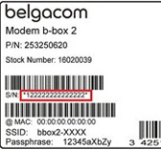
Router identity
Internet Gateway (Modem/Router) Nameplate
SSID – is the name of the gateway that you search for for WiFi
This SSID is standard on all models with the excepts of a few numbers at the end.
Default WiFi Password – each router comes standard with a generated password, which typical resembles the SSID
There are lists of these SSID numbers and default passwords out on the black market and can be used to access your home network.
To prevent this contact your Internet Service Provider (ISP) to help you change both your WiFi Password and SSID.

Slide 36
WiFI – Home and Public (open)
Home WiFi
This should NOT be made open.
You SHOULD always password protect it.
Your computer should prompt you to label this network as either work, home, or public, which helps to secure some of your information when using the home network.
Public (Open) WiFi
These are the free internet access places you see at McDonalds, Starbucks, City Libraries, etc.
They can be great for quick access to website while you are out.
They should not be used for transmission of secure information.

Slide 37
Part vii: what to do after becoming a victim
How to recover some sense of self after a scammer has attacked you

Slide 38
Overview of Steps: SCRCC
Securing Your Accounts
Change Your Passwords
File A Police Report
Contact Your Utilities
Check Your Computers

Slide 39
Secure your accounts
Contact your banks and credit card companies to lock your accounts and report the fraud. You can do this 24/7, then follow up to get new cards or even a new account issued.
Additionally, contact all three credit bureaus to check your credit reports. Experian, Equifax, and TransUnion

Slide 40
Change your passwords
Change your passwords on all email, social media, and various other accounts to include your bank.
01
Do this even if you use a password manager.
02
Collect any paperwork that can help show account totals missing or personal information related to the fraud
03

Slide 41
File A police report
Call the local police to report the fraud and provide all the information you can. Bring bank statements, credit card transactions, etc.
This needs to be done relatively fast, but can be done a few days later if you need to gather these documents. Bring you government issued ID with you.
File a report online with the Federal Trade Commission at www.FTC.gov who monitors trends and provides tips.

Slide 42
Contact your utilities
You may need to contact your ISP, Cell Phone, Cable/Sat, or Phone Company if any of these apply to the fraud.
Your ISP can help additionally with securing your home network.

Slide 43
Check your system
Have you computer checked by a trusted professional.
If you do not have someone you know or trust then take it to a place like Geek Squad (Best Buy), or contact your local computer retailer for other trusted sources.
Use caution if you call someone to come to your location.
Additionally, use caution if you utilize an online computer repair company.

Slide 44
Part viii: Beyond this course
Resources, tools, and other goodies to help further your new education

Slide 45
Types of hacking attacks
Man-in-the-Middle Attacks
Denial of Service Attacks (DNS)
Drive-by Attacks
Phising/Spear Phising Attacks
Password Attacks
SQL Injection Attacks

Slide 46
conclusion
Online Security can be accomplished and doesn’t have to seem scary or inevitable. By take precautionary steps to ensure security you can secure your PII and online presence. Online criminals like to prey on their victims, but simple steps can be taken keep you from becoming a victim of fraud.
As the laws change in the United States and across the globe more action and accountability will be available to help citizens feel secure.
Always remember:
If the offer seems too good to be true, it probably is.
Seek help first, education is power.

Slide 47
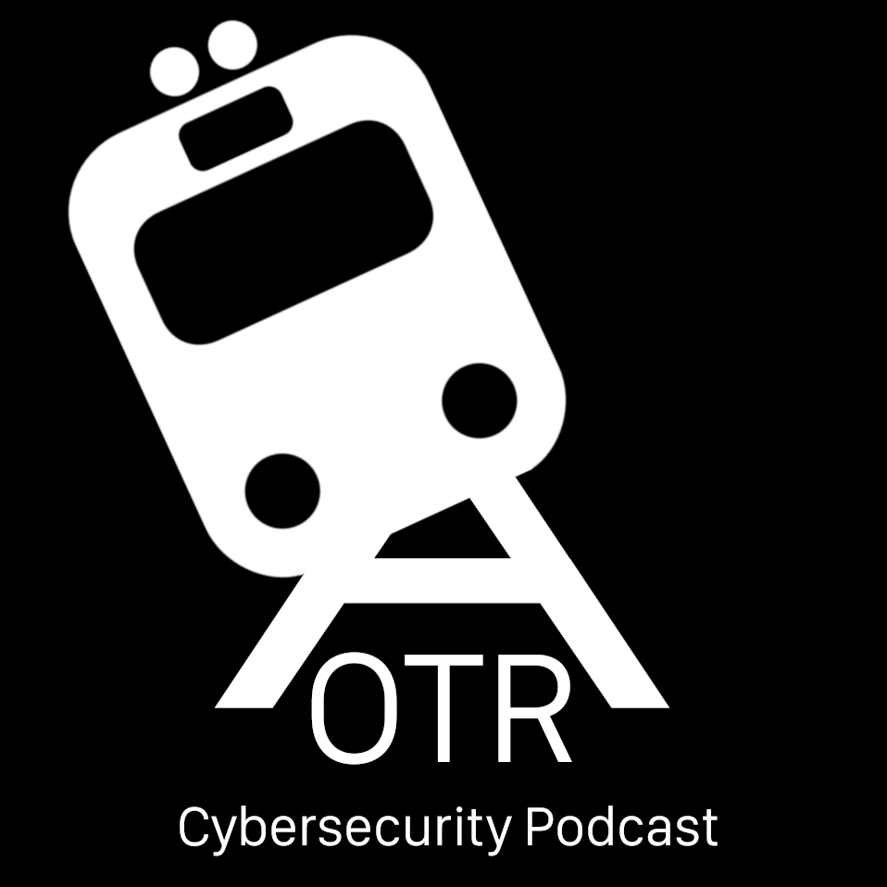
Off the rails Cyber security podcast
Website: https://offtherailspod.github.io
Email: offtherailsconnect@gmail.com
Facebook: https://www.facebook.com/OffTheRailPodcast/
Twitter: https://twitter.com/OffTheRails12
Github: https://github.com/offtherailspod/offtherailspod.github.io

